Slide 1
Pipelined Processor Design
P. K. Roy
Asst. Professor
Siliguri Institute of Technology

Slide 2
Introduction
Pipelining is one way of improving the overall processing performance of a processor
A basic technique to improve performance - always applied in high performance systems.
The operation of the processor are divided into a number of sequential actions.
Each action is performed by a separate logic unit which are linked together in a “pipeline.”

Slide 3
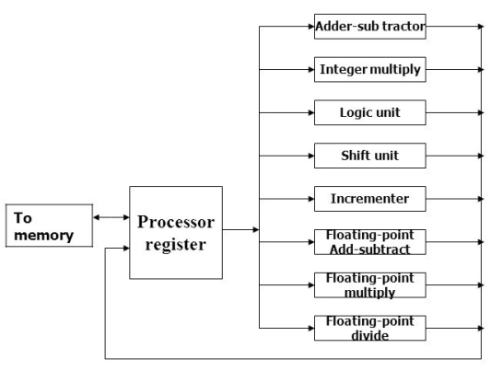
Processors with multiple functional units

Slide 4
Types of Pipelined processors
Degree of overlap
Serial, Overlapped, Pipelined, Super-pipelined
Depth
Shallow, Deep
Structure
Linear, Non – linear
Scheduling of operations
Static, Dynamic

Slide 5
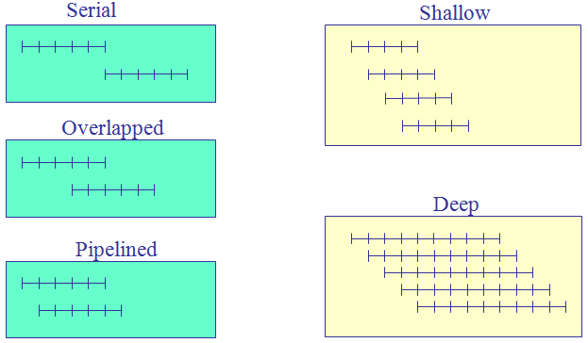
Degree of overlap Depth

Slide 6
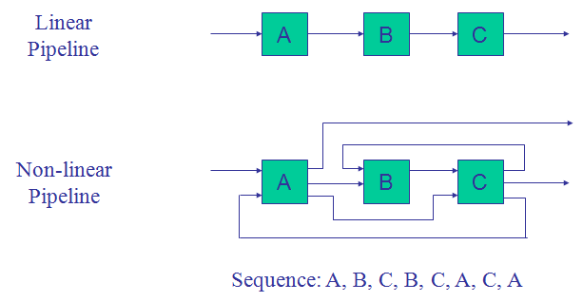
Pipeline Structure

Slide 7
Scheduling/timing alternatives
Static
same sequence of stages for all instructions
all actions in order
if one instruction stalls, all subsequent instructions are delayed
Dynamic
above conditions are relaxed
higher throughput is achieved

Slide 8
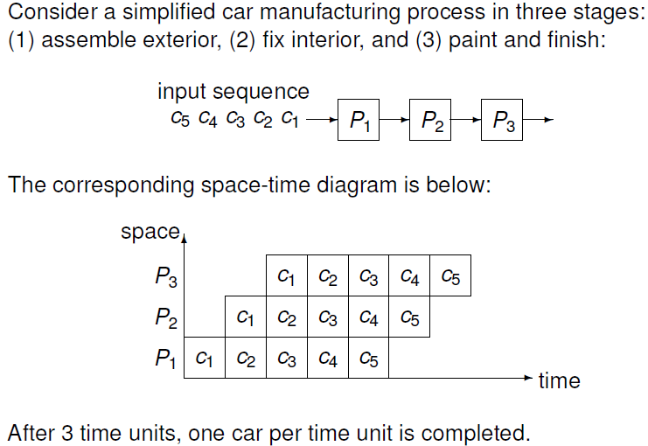
Space-Time Diagram
To represent the overlapped operations of a pipelined processor

Slide 9
p-stage pipelines
A pipeline with p processors is a p-stage pipeline.
Suppose every process takes one time unit to complete.
- How long till a p-stage pipeline completes n inputs?
A p-stage pipeline on n inputs:
- After p time units the first input is done.
- Then, for the remaining n − 1 items, the pipeline completes at a
rate of one item per time unit.
=> p + n − 1 time units for the p-stage pipeline to complete n inputs.
A time unit is called a pipeline cycle.
The time taken by the first p − 1 cycles is the pipeline latency.

Slide 10
Reservation Table
A 2D chart to show how successive parallel stages are utilized for a specific function (o/p) evaluation in successive cycles.
Represents the flow of data through the pipeline for one complete evaluation of a given function.
The total no. of clock units in the reservation table is the evaluation time for the given function.

Slide 11
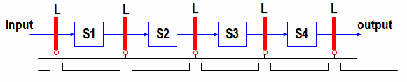
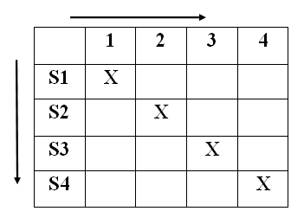
Example (Linear/Static Pipeline)
(X)
Clock
Time
Stage

Slide 12
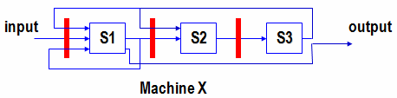
Non-linear (or Dynamic) Pipeline
Stages might have different latencies
Multiple paths out of one stage to other stages
Multi-functional
Multiple processors (k-stages) as linear pipeline
Variable functions of individual processors
Functions may be dynamically assigned
Feed-forward and feedback connections
X

Slide 13
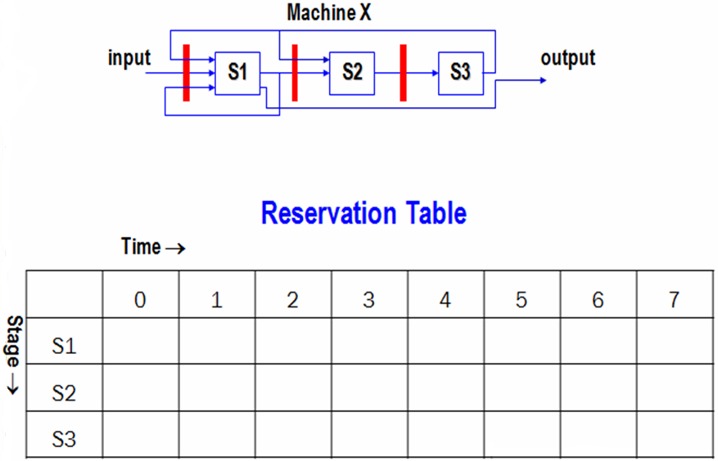
Reservation Table

Slide 14
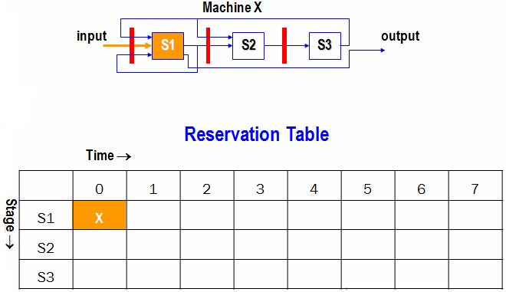
Reservation Table

Slide 15
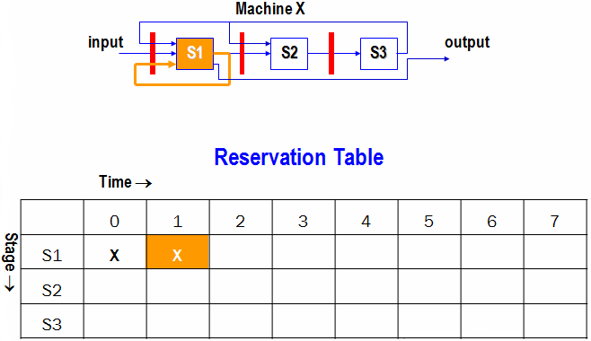
Reservation Table

Slide 16
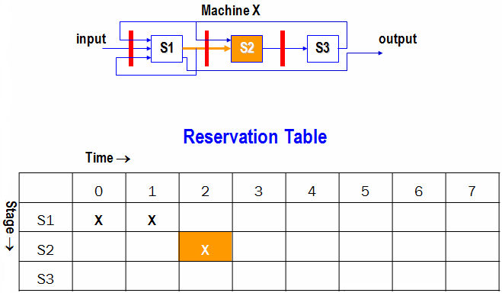
Reservation Table

Slide 17
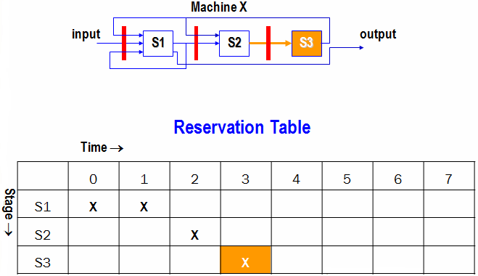
Reservation Table

Slide 18
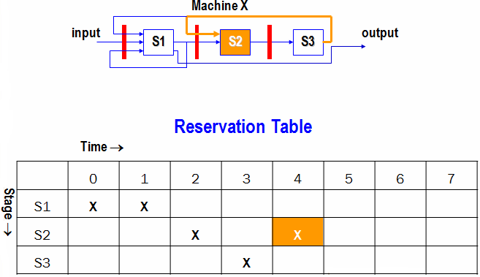
Reservation Table

Slide 19
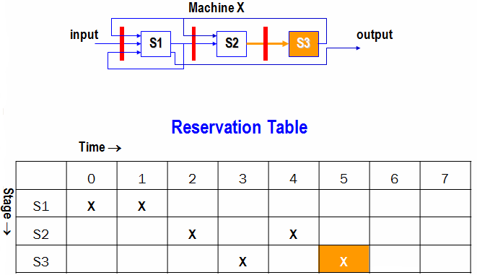
Reservation Table

Slide 20
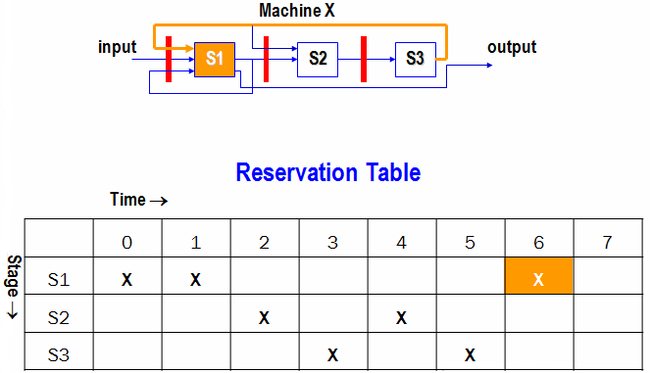
Reservation Table

Slide 21
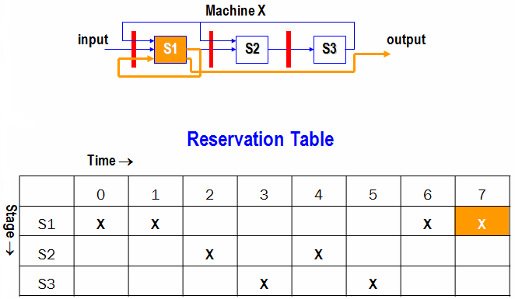
Reservation Table

Slide 22
Exercise 1:
Design the pipeline for both cases.
1.
2.
X |  |  |  |  | X |  | X
 | X |  | X
 |  | X |  | X |  | X
 | 1 | 2 | 3 | 4 | 5 | 6 | 7
A | X |  | X | X
B |  | X |  |  |  | X
C |  |  |  |  | X |  | X
D |  |  |  | X

Slide 23
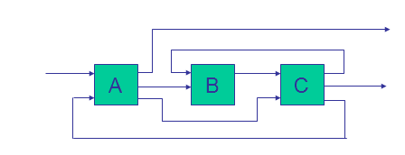
Non-linear Pipeline With More Than One Functions
X
Y
2 Streamline Connections
2 Feedback Connections
1 Feedforward Connection

Slide 24
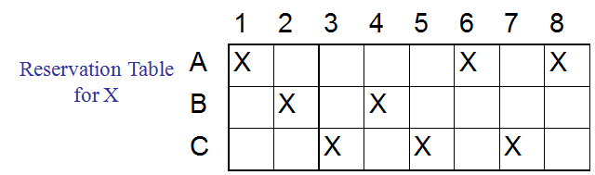
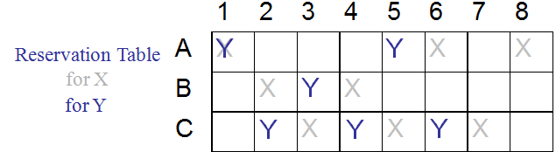
Reservation Table
Columns represent the evaluation time for a given function
2. Multiple checkmarks in a row, means repeated usage of the same stage in different cycles

Slide 25
Latency Analysis
Latency: The number of time units (clock cycles) between two initiations of a pipeline is the latency between them.
A latency value k means that two initiations are separated by k clock cycles.
Any attempt by two or more initiations to use the same pipeline stage at the same time will cause a collision.
A collision implies resource conflicts between two initiations in a pipeline.
Latencies that cause collision are called forbidden latencies.
Some latencies cause collision, some not.

Slide 26
Latency Analysis
Maximum forbidden latency can be m
– If n = no. of columns in the reservation table then m ≤ n-1
All the latencies greater than m+ do not cause collisions.
Permissible Latency p, lies in the range:
– 1 ≤ p ≤ m-1
– Value of p should be as small as possible
– Permissible latency p=1 corresponds to an
ideal case, can be achieved by a static pipeline

Slide 27
Latency Analysis
Latency Sequence: a sequence of permissible latencies between successive initiations.
Latency Sequence Length: the number of time intervals within the cycle.
Latency Cycle: a latency sequence that repeats the same subsequence (cycle) indefinitely and without collision.
e.g. Latency Sequence: 1, 8
Latency Cycle → (1,8) → 1, 8, 1, 8, 1, 8 …
Minimum Average Latency (MAL of a latency cycle):
sum of all latencies / number of latencies along the cycle
Constant Cycle: One latency value.
Design Goal: Obtain the shortest average latency between initiations without causing collisions.

Slide 28
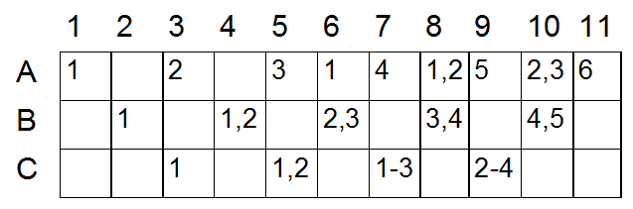
Collision with latency 2 in evaluating X

Slide 29
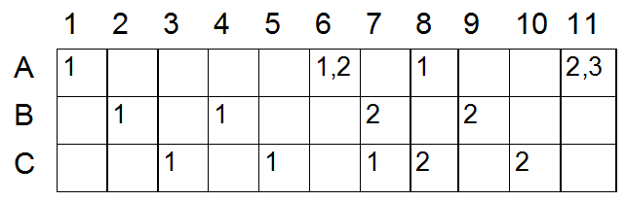
Collision with latency 5 in evaluating X

Slide 30
Collision Vectors
Combined set of permissible and forbidden latencies.
m-bit binary vector C = (Cm Cm-1….C2 C1 )
The value of Ci = 1 if the latency i causes a collision;
Ci = 0 if the latency i is permissible.
Cm = 1, always; it corresponds to the maximum forbidden latency m ≤ n-1.
Forbidden latencies for function X are 2,4,5,7
Latencies 1,3,6 do not cause collision.
Therefore, the collision vector is = 1011010

Slide 31
State Diagram
It specifies the permissible state transitions among successive initiations.
Collision vector corresponds to the initial state at time t = 1 (initial collision vector).
The next state comes at time t + p, where p is a permissible latency in the range 1 ≤ p < m.

Slide 32
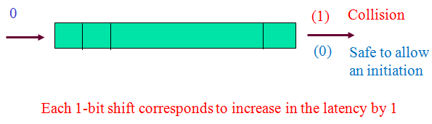
Right Shift Register
The next state of the pipeline at time t+p can be obtained by using a bit-right shift register.
Initial CV is loaded into the register.
The register is then shifted to the right
– When a 0 emerges from the right end after p shifts, p is a permissible latency.
– When a 1 emerges, the corresponding latency should be forbidden.
Logical 0 enters from the left end of the shift register.

Slide 33
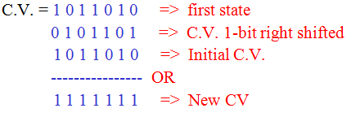
The Next State
The next state after p shifts is obtained by bitwise-ORing the initial
CV with the shifted register contents.
This bitwise-ORing of the shifted contents is meant to prevent collisions from the future initiations starting at time t+1 and onward.

Slide 34
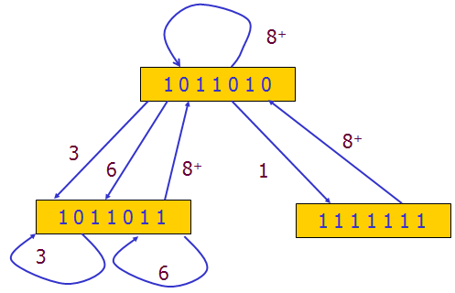
State Diagram for X
HW: Find the state diagram for Y

Slide 35
Cycles
Simple cycles: each state appears only once
(3), (6), (8), (1, 8), (3, 8), and (6,8)
Greedy Cycles: simple cycles whose edges are all made with minimum latencies from their respective starting states
(1,8), (3): one of them is MAL

Slide 36
Bounds on MAL
MAL is lower-bounded by the maximum number of checkmarks in any row of the reservation table.
MAL is lower than or equal to the average latency of any greedy cycle in the state diagram.
Average latency of any greedy cycle is upper-bounded by the number of 1’s in the initial CV plus 1.

Slide 37
Collision-free scheduling
Finding Greedy cycles from the set of Simple cycles.
The Greedy cycle yielding the MAL is the final choice.

Slide 38
Optimization technique
Insertion of Delay stages
– Modification of reservation table
– New CV
– Improved state diagram
To yield an optimal latency cycle
Optimal latency cycle is selected from one of the
lowest greedy cycles.

Slide 39
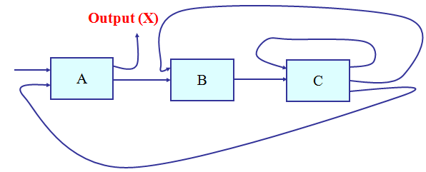
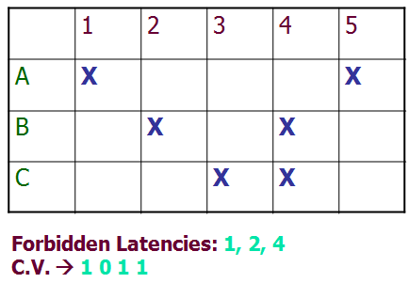
Example

Slide 40
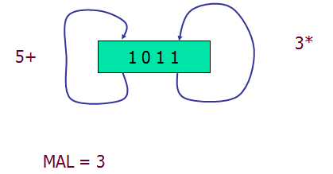
Example(cntd..): State Diagram

Slide 41
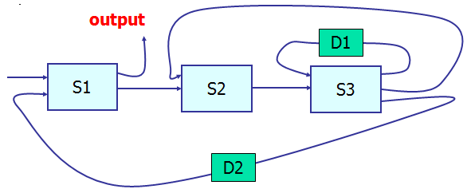
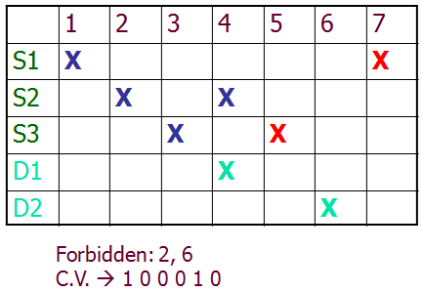
Example(cntd..): Delay Insertion
HW: Find the State Diagram

Slide 42
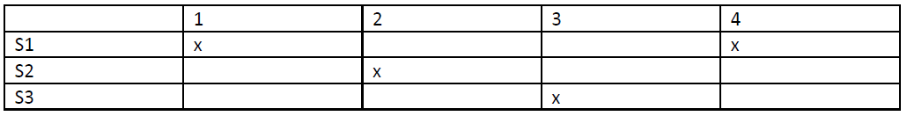
Exercise 2:
Find out (i) Forbidden latency
(ii) Initial collision vector
(iii) Draw the state diagram for scheduling the pipeline
(iv) Greedy cycle and MAL
(v) Bounds on MAL

Slide 43
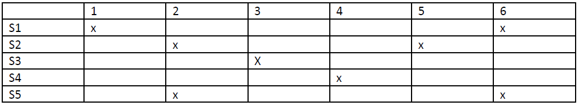
Exercise 3:
Find out (i) Forbidden latency
(ii) Initial collision vector
(iii) Draw the state diagram for scheduling the pipeline
(iv) Greedy cycle and MAL
(v) Bounds on MAL

Slide 44
Classification of Pipelined Processors
Arithmetic Pipeline
- Divides an arithmetic operation into several steps each of which
executed one-by-one.
- e.g. 4-stage pipeline used in Star-100,
8-stage pipeline used in TI-ASC
Instruction Pipeline
- Basic stages are Fetch-Decode-Execute but can be expanded.
- e.g. all high performance computers
Processor Pipeline
- processing of same data stream by cascade of processors
- no practical example found

Slide 45
Arithmetic Pipeline
combined multiply and add operations with a stream of numbers:
A_{i} * B_{i} + C_{i} for i =1,2,3,…,7
The suboperations performed in each segment of the pipeline are as follows:
R1 ← A_{i}, R2 ← B_{i}
R3 ← R1 * R2 R4 ← C_{i}
R5 ← R3 + R4

Slide 46
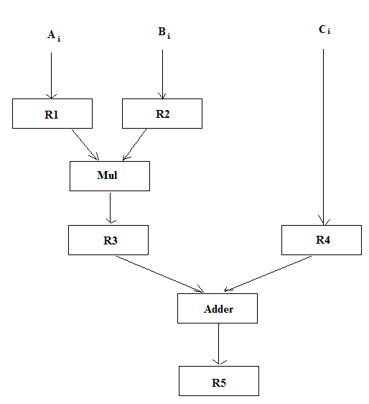
Arithmetic Pipeline

Slide 47
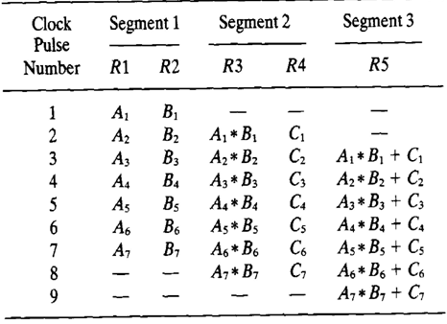
Arithmetic Pipeline

Slide 48
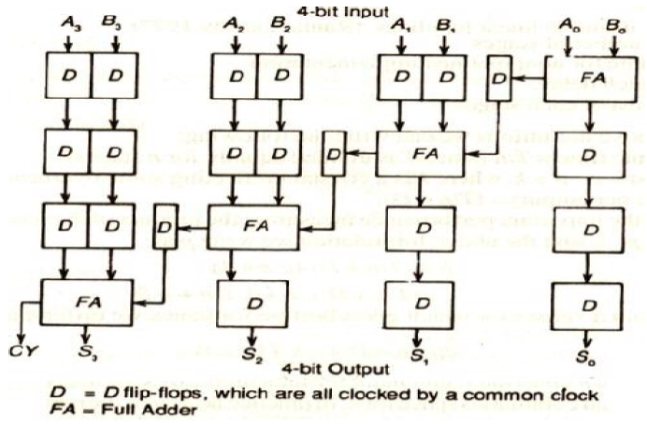
Fixed Point Addition Pipeline

Slide 49
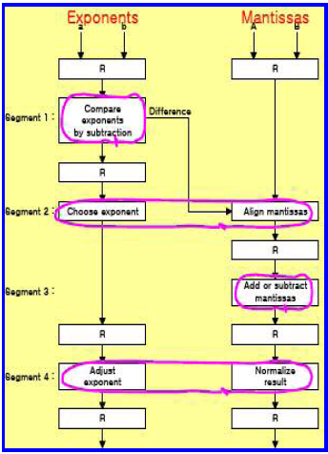
Floating Point Addition/Subtraction Pipeline

Slide 50
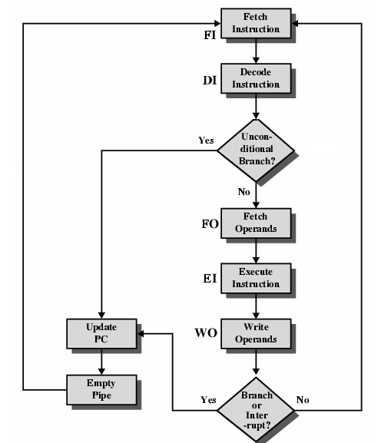
5-Stage Instruction Pipeline
Self-review: Pipelining from CS303

Slide 51
Five stages in the datapath of MIPS
Five stage “RISC” load‐store architecture
1. Instruction fetch (IF)
– get instruction from memory, increment PC
2. Instruction Decode (ID)
– translate opcode into control signals and read registers
3. Execute (EX)
– perform ALU operation, compute jump/branch targets
4. Memory (MEM)
– access memory if needed
5.Writeback (WB)
– update register file

Slide 52
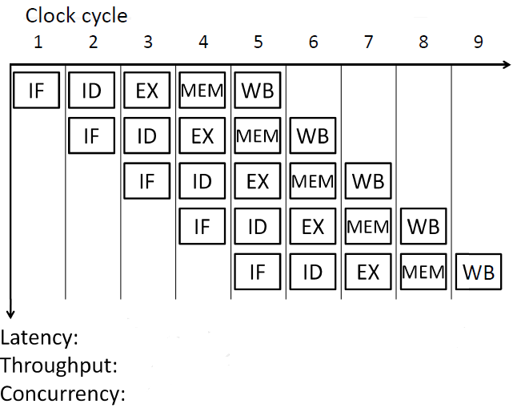
5 cycles
CPI : 1
1 Instruction/cycle
5

Slide 53
Pipeline Conflicts/Hazards
Data Dependency => Data hazard
Branch Difficulties => Control hazard
Resource Conflicts => Structural hazard

Slide 54
Data Hazard
Consider the instruction sequence:
ADD R1, R2, R3; results in R1
SUB R4, R5, R1;
AND R6, R1, R7;
OR R8, R1, R9;
XOR R10, R1, R11;
All instructions use R1 after the first instruction.

Slide 55
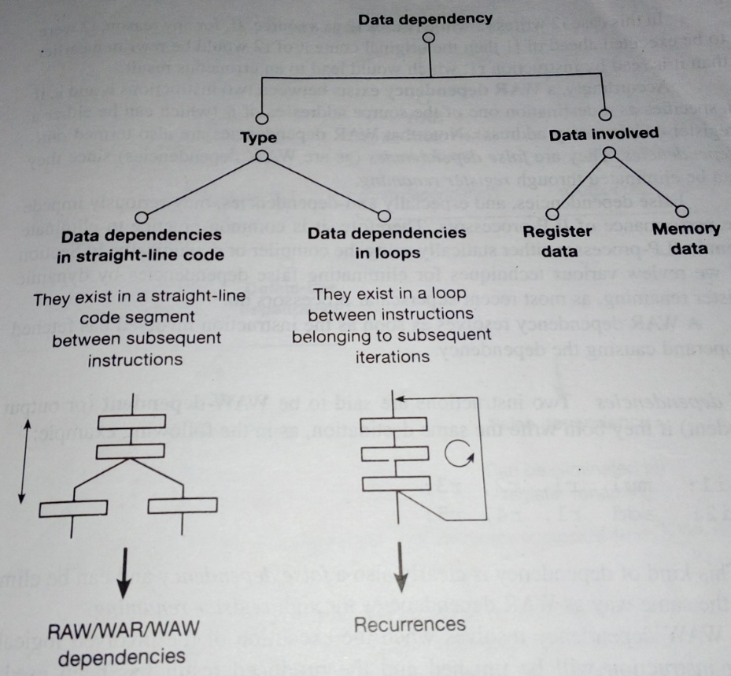
Data Dependency
Ref: “Advanced Computer Architecture”, Peter Karsuk

Slide 56
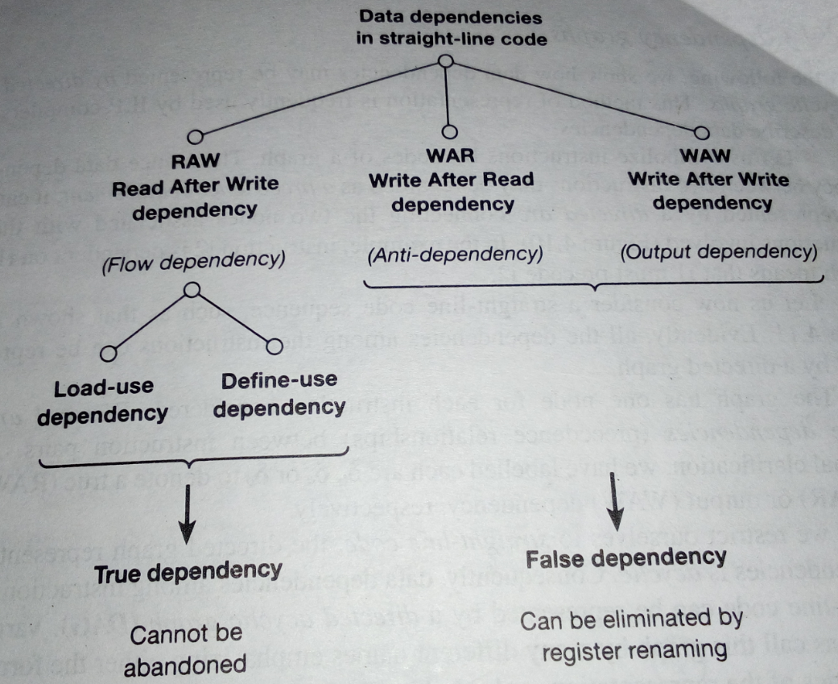
Data Dependency
Ref: “Advanced Computer Architecture”, Peter Karsuk

Slide 57
Data Hazard Classification
According to various data update patterns in instruction pipeline, there are 3 classes of data hazards exist:
RAW(Read After Write)
WAR(Write After Read)
WAW(Write After Write)

Slide 58
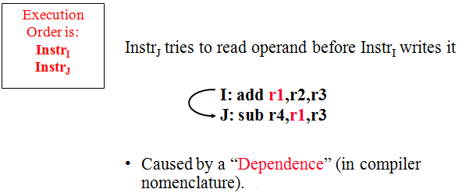
RAW(Read After Write)

Slide 59
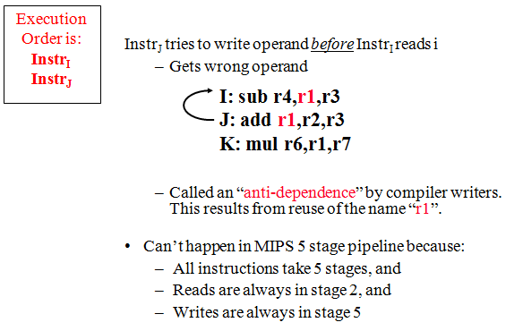
WAR(Write After Read)

Slide 60
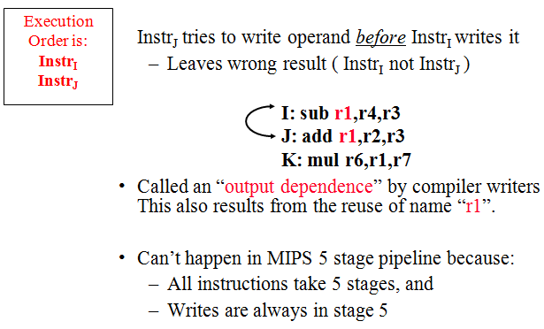
WAW(Write After Write)

Slide 61

Data Hazard – Stalling (S/W Solution)
Causes Data Dependency
Bubbling: Compiler can introduce the two-cycle delay needed between instructions I1 and I2 by inserting NOP (No-operation) instructions.
I1: Mul R4,R2,R3
NOP
NOP
I2: Add R6,R4,R5

Slide 62
Data Hazard – Stalling (S/W Solution)

Slide 63
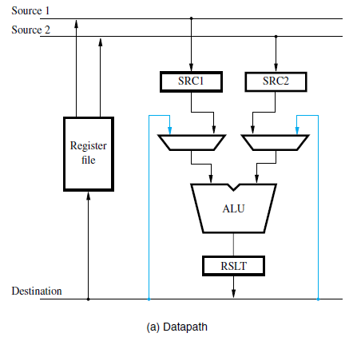
Data Hazards – Forwarding
Requires additional H/W
Registers SRC1, SRC2, and RSLT constitute the interstage buffers needed for pipelined operation.

Slide 64
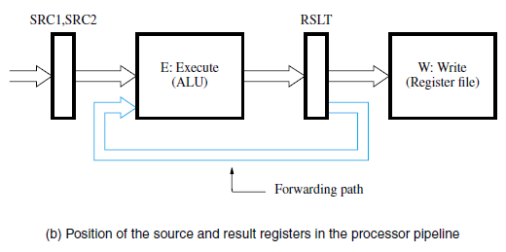
Data Hazards – Forwarding

Slide 65
Data Hazards - Forwarding
Key idea: connect new value directly to next stage
Still read s0, but ignore in favor of new result
Problem: what about load instructions?

Slide 66
Data Hazards - Forwarding
STALL still required for load - data available after MEM
MIPS architecture calls this delayed load, initial implementations required compiler to deal with this

Slide 67
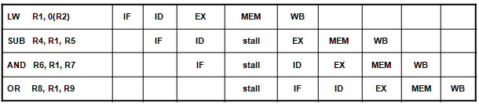
Another Example: Stalling + Forwarding

Slide 68
Data Hazards - Reordering Instructions
Assuming we have data forwarding, what are the hazards in this code? lw $t0, 0($t1)
sw $t0, 4($t1) lw $t2, 4($t1) sw $t2, 0($t1)
Reorder instructions to remove hazard:
lw $t0, 0($t1) lw $t2, 4($t1) sw $t0, 4($t1) sw $t2, 0($t1)
Data Hazard
Reordering

Slide 69
Control Hazard
Delay in fetching instruction.
Cache miss
Branch Instructions.
Solutions:
Prefetching
Delayed Branching
Branch Prediction
Instruction/Control Hazard

Slide 70
Prefetching
Memory is assumed to be a collection of multiple modules.
2 pre-fetch buffers (caches)
Sequential Prefetch Buffer
- holds instructions fetched during the sequential part
of a program.
Target Prefetch Buffer
- holds instructions fetched from the target of a
conditional branch.

Slide 71

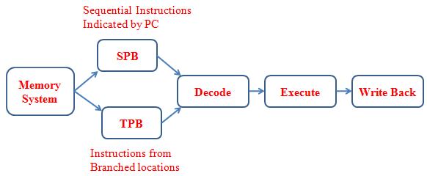
Pre-fetching

Slide 72
Delayed Branching
branch instruction sequential successor₁ sequential successor₂ ........ sequential successor_{n}
branch target if taken
Solution:
- Possible to improve pipeline performance by
rearranging instructions.
- Use of delay slots to execute independent
instructions.
Branch delay of length n (Delay Slot)

Slide 73
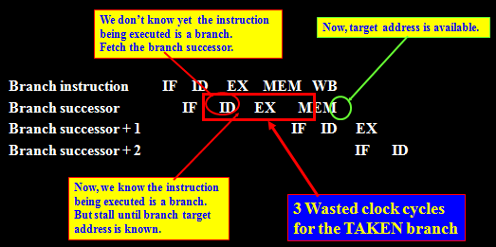
Delayed Branching

Slide 74
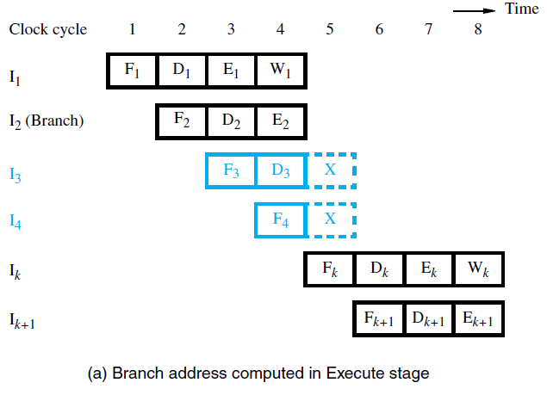
Delayed Branching

Slide 75
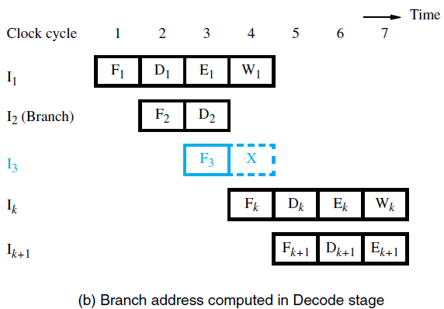
Delayed Branching

Slide 76
Example: Delayed Branching
I1: LD R1, A
I2: DCR R3, 1
I3: BZ R3, I5
I4: ADD R2, R4
I5: SUB R5, R6
If Branch Taken => Delay Slots
If Branch not Taken => Normal execution
2 possibilities
– Branch Taken
– Branch not Taken

Slide 77
Example: Delayed Branching
Time
1 | 2 | 3 | 4 | 5 | 6 | 7 | 8 | 9 | 10 | 11
F1 | D1 | E1 | M1 | W1
 | F2 | D2 | E2 | M2 | W2
 |  | F3 | D3 | E3 | M3 | W3
 |  |  | F4 | D4 | E4 | M4 | W4
 |  |  |  | O | O | O | O | O
 |  |  |  |  | F5 | D5 | E5 | M5 | W5
I1:
I2:
I3:
Stall (I4)
Stall
I5:

Slide 78
Example: Delayed Branching
I2: DCR R3, 1
I3: BZ R3, I5
I1: LD R1, A
I4: ADD R2, R4
I5: SUB R5, R6
If Branch Taken => Use of Delay Slots
If Branch not Taken => Normal execution
Reordering of Instructions

Slide 79
Example: Delayed Branching
Time
1 | 2 | 3 | 4 | 5 | 6 | 7 | 8 | 9
F2 | D2 | E2 | M2 | W2
 | F3 | D3 | E3 | M3 | W3
 |  | F1 | D1 | E1 | M1 | W1
 |  |  | F4 | D4 | E4 | M4 | W4
 |  |  |  | F5 | D5 | E5 | M5 | W5
I2:
I3:
I1:
I4:
I5:

Slide 80
Branch Prediction
Assume an outcome and continue fetching (undo if prediction is wrong) .
Loss of cycles only on mis-prediction
Performance penalty only when guess wrong
Hardware required to "squash" instructions
Static Prediction:
- Prediction is made based on the type of branch codes.
- cannot be changed once committed to the H/W.
Dynamic Prediction:
- Prediction is made based on the recent branch history.
- Requires additional H/W to keep track of the past behavior of the branch instruction (e.g. Branch Target Buffer to hold recent branch information including the address of the branch target used).

Slide 81
Branch Prediction
Predicting branch not taken:
Speculatively fetch and execute in-line instructions following the branch
If prediction incorrect flush pipeline of speculated instructions
Convert these instructions to NOPs by clearing pipeline registers
These have not updated memory or registers at time of flush
Predicting branch taken:
Speculatively fetch and execute instructions at the branch target address
Useful only if target address known earlier than branch outcome
May require stall cycles till target address known
Flush pipeline if prediction is incorrect
Must ensure that flushed instructions do not update memory/registers

Slide 82
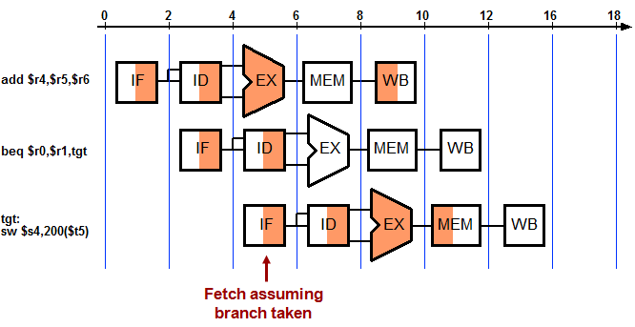
Correct Prediction

Slide 83

Incorrect Prediction

Slide 84

1-Bit Branch Prediction

Slide 85

2-Bit Branch Prediction (Jim Smith, 1981)
A 2-bit scheme where prediction is changed only if mispredicted twice.

Slide 86

References
PPT on Pipelining from CS303 (3rd Semester)
Advanced Computer Architecture – Kai Hwang
Computer Organization – Carl Hamacher
Advanced Computer Architectures – Dezso Sima, Peter Karsuk
Computer Architecture & Organization – John P. Hayes
Computer System Architecture – M. Morris Mano
Computer Organization & Architecture – T. K. Ghosh
Computer Organization & Architecture – Xpress Learning

